Slide 1
ASSIGNMENT
Name: VINAY KUMAR PARASHARA BATTER
Problem Statement
The sales pipeline conversion percentage at TechnoServe (a tech SaaS startup) has dropped
from 35% at the end of last fiscal (FY 2017-18) to 25% at present.
Assignment Objective
Understand the problem, come up with a hypothesis for low conversions faced by
TechnoServe, and analyse the dataset provided to arrive at possible solutions to increase it.

Slide 2
PART I : 1. Understanding the Problem
Sales Pipeline Conversion at a SaaS Startup
Who?
TechnoServe (a tech SaaS startup)
What?
Sales Pipeline conversion percentage has dropped from 35% to 25%
When?
Current fiscal (FY 2018-19)
Where?
Among the customers or Leads of the company
How?
Not targeting the customers properly
Product not meeting the requirements or expectations of Present market

Slide 3
PART I : 2. Understanding the Problem
Sales Pipeline Conversion at a SaaS Startup
Situation
How many leads and Clients does the TechnoServe has?
What are the products offered by the TechnoServe and How do they fare for products?
What is the Strength of the Sales team at the company?
Problem
How does the company identify the leads?
Is the Sales Team at
TechnoServe effective?
Are there certain products which are fare badly at TechnoServe?
Implication
What is the impact of dropped sales pipeline conversion percentage on TechnoServe?
Does the low pipe conversion affect the Sales team of TechnoServe?
Are there issues with the products at TechnoServe?
Need-Payoff
Will it improve Dropped Sales pipeline conversion percentage?
Will it be helpful in generating extra Revenue?
Will it increase the market share of TechnoServe?

Slide 4
PART II : Formulating Hypotheses
Sales Pipeline Conversion at a SaaS Startup
Framework Used
Issue Tree Framework in conjuction with 5C Framework
Reason for using the selected framework
It is easy to cover all the domains of TechnoServe
How you have used the framework here
The problem has been divided into 5C’s in the framework and then each C is branched using issue tree framework

Slide 5
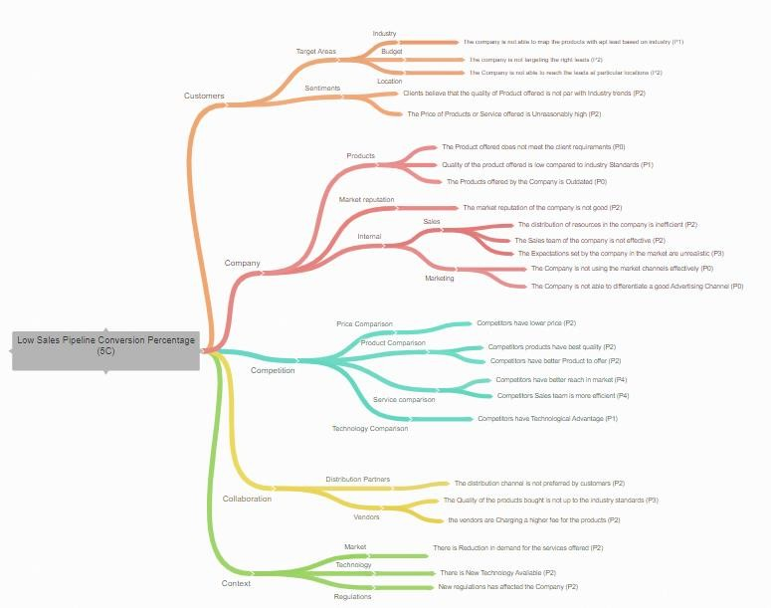
PART II : Formulating Hypotheses
Sales Pipeline Conversion at a SaaS Startup

Slide 6
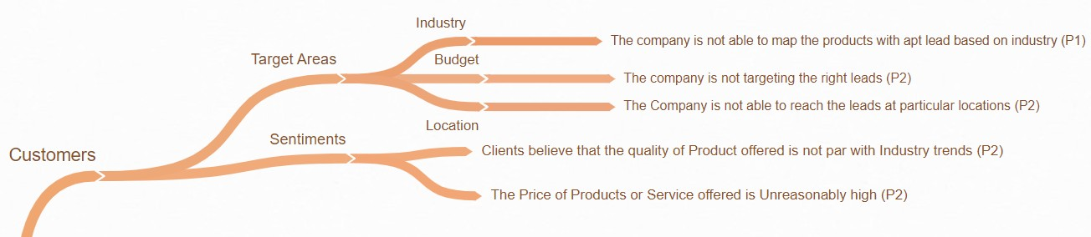
PART II : Formulating Hypotheses
Sales Pipeline Conversion at a SaaS Startup

Slide 7
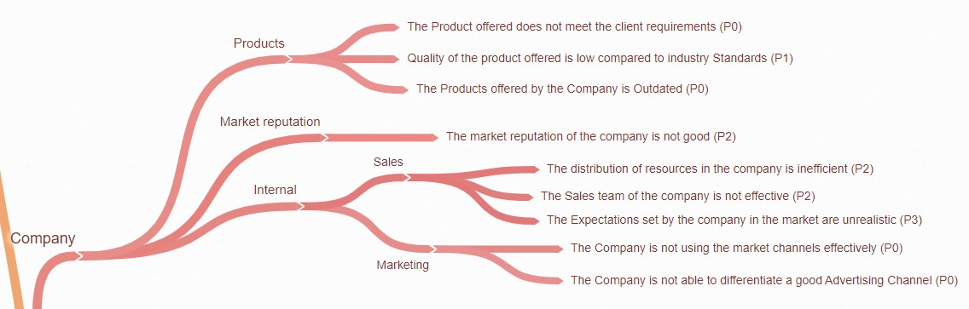
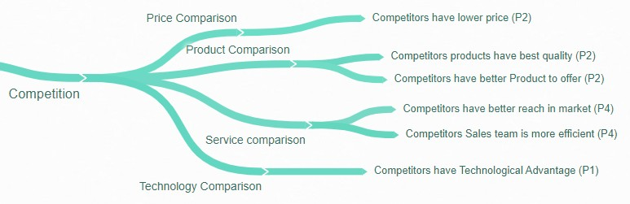
PART II : Formulating Hypotheses
Sales Pipeline Conversion at a SaaS Startup

Slide 8
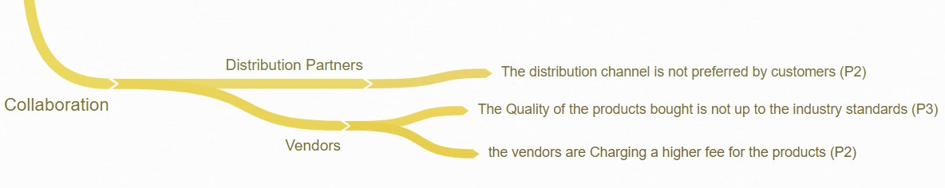
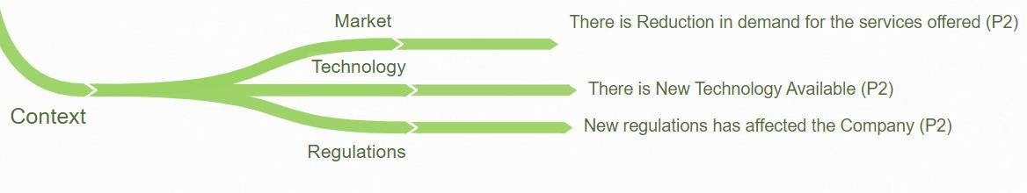
PART II : Formulating Hypotheses
Sales Pipeline Conversion at a SaaS Startup

Slide 9
PART II : Formulating Hypotheses
Sales Pipeline Conversion at a SaaS Startup
Branch 1: Low Sales Pipeline Conversion Percentage- Customer- Target Areas- Industry
The Company is not able to map the Products with apt lead based on Industry (P1)
Branch 2: Low Sales Pipeline Conversion Percentage- Customer- Target Areas- Budget
The Company is not targeting the Right Leads (P2)

Slide 10
PART II : Formulating Hypotheses
Sales Pipeline Conversion at a SaaS Startup
Branch 3: Low Sales Pipeline Conversion Percentage- Customer- Target Areas- Location
The Company is not able to reach the Leads at particular locations (P2)
Branch 4: Low Sales Pipeline Conversion Percentage- Customer- Sentiments
Clients believe that the quality of the product offered is not par with industry trends (P2)
The Price of Product or Service offered is reasonably high (P2)

Slide 11
PART II : Formulating Hypotheses
Sales Pipeline Conversion at a SaaS Startup
Branch 5: Low Sales Pipeline Conversion Percentage- Company- Products
The Product offered does not meet the client requirements (P0)
Quality of the product offered is low compared to industry Standards (P1)
The Products offered by the company is outdated (P0)
Branch 6: Low Sales Pipeline Conversion Percentage- Company- Market Reputation
The Market Reputation of the company is not good (P2)

Slide 12
PART II : Formulating Hypotheses
Sales Pipeline Conversion at a SaaS Startup
Branch 7: Low Sales Pipeline Conversion Percentage- Company- Internal- Sales
The Distribution of resources in the company is inefficient (P2)
The Sales team of the company is not effective (P2)
The Expectations set by the company in the market are unrealistic (P3)
Branch 8: Low Sales Pipeline Conversion Percentage- Company- Internal- Marketing
The company is not using the market channels effectively (P0)
The Company is not able to differentiate good advertising channel (P0)

Slide 13
PART II : Formulating Hypotheses
Sales Pipeline Conversion at a SaaS Startup
Branch 9: Low Sales Pipeline Conversion Percentage- Competition- Price Comparison
Competitors have lower price (P2)
Branch 10: Low Sales Pipeline Conversion Percentage- Competition- Product Comparison
Competitors products have best quality (P2)
Competitors have better product to offer (P2)

Slide 14
PART II : Formulating Hypotheses
Sales Pipeline Conversion at a SaaS Startup
Branch 11: Low Sales Pipeline Conversion Percentage- Competition- Service Comparison
Competitors have better reach in market (P4)
Competitors Sales team is more efficient (P4)
Branch 12: Low Sales Pipeline Conversion Percentage- Competition- Technology Comparison
Competitors have Technological Advantage (P1)

Slide 15
PART II : Formulating Hypotheses
Sales Pipeline Conversion at a SaaS Startup
Branch 13: Low Sales Pipeline Conversion Percentage- Collaboration- Distribution partners
The distribution channel is not preferred by customers (P2)
Branch 14: Low Sales Pipeline Conversion Percentage- Collaboration- Vendors
The quality of the products bought is not up to the industry standards (P3)
The Vendors are charging a higher fee for the products (P2)

Slide 16
PART II : Formulating Hypotheses
Sales Pipeline Conversion at a SaaS Startup
Branch 15: Low Sales Pipeline Conversion Percentage- Context- Market
There is Reduction in demand for the services offered P2)
Branch 16: Low Sales Pipeline Conversion Percentage- Context- Technology
There is New Technology Available (P2)

Slide 17
PART II : Formulating Hypotheses
Sales Pipeline Conversion at a SaaS Startup
Branch 17: Low Sales Pipeline Conversion Percentage- Context- Regulations
New regulations has affected the Company (P2)

Slide 18
PART III A : Generating Insights
Sales Pipeline Conversion at a SaaS Startup
Variable
Technology Primary
B2B Sales medium
Client Revenue Sizing
Business From Client Last Year
Opportunity Sizing
Insights if any
Unusually large number of Opportunities come from ERP Implementation Category and they have better opportunity Conversion rate than Average Opportunity Conversion Rate
Most opportunities are from Marketing and Enterprise Sellers with the Enterprise Sellers having a better opportunity conversion rate than average opportunity conversion rate
Unusually large number of opportunities come from clients in revenue size 100K or less
The conversion rate is higher for existing customers despite the number of opportunities unusually large from newer customers
The opportunity conversion rate is significantly higher for
clients with potential revenue in 0-30K range
Pattern of Insight
Significant Outlier
Significant Outlier
Significant Outlier
Significant Outlier
Surprising Comparison

Slide 19
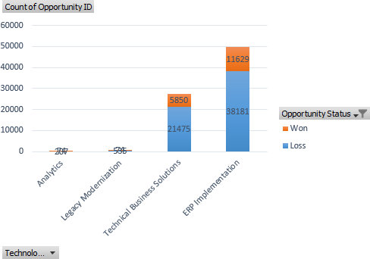
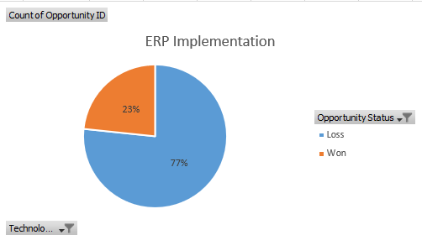
PART III A : Generating Insights
Sales Pipeline Conversion at a SaaS Startup
Variable under consideration: Technology Primary
Unusually large number of Opportunities come from ERP Implementation Category and they have better opportunity Conversion rate than
Average Opportunity Conversion Rate

Slide 20
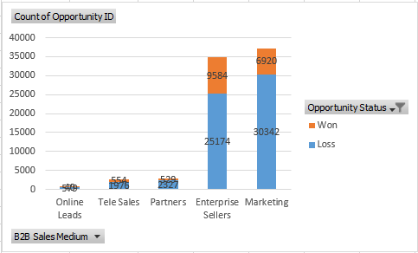
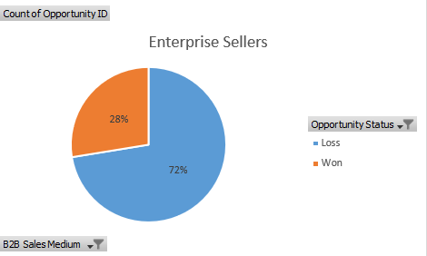
PART III A : Generating Insights
Sales Pipeline Conversion at a SaaS Startup
Variable under consideration: B2B Sales Medium
Most opportunities are from Marketing and Enterprise Sellers with the Enterprise Sellers having a better opportunity conversion rate than
average opportunity conversion rate

Slide 21
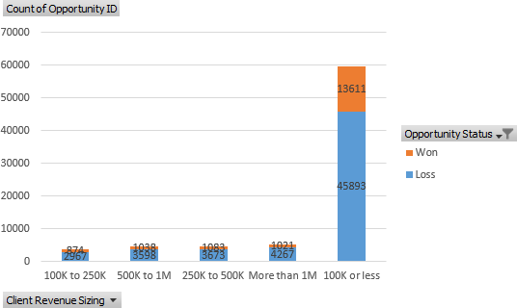
PART III A : Generating Insights
Sales Pipeline Conversion at a SaaS Startup
Variable under consideration: Client Revenue Sizing
Unusually large number of opportunities come from clients in revenue size 100K or less

Slide 22
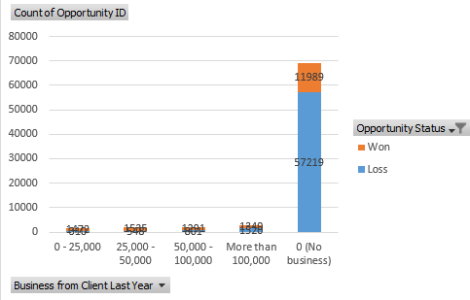
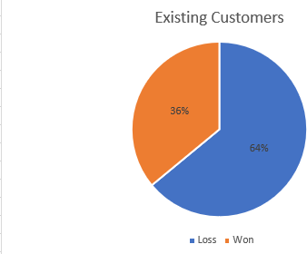
PART III A : Generating Insights
Sales Pipeline Conversion at a SaaS Startup
Variable under consideration: Business From Client Last Year
The conversion rate is higher for existing customers despite the number of opportunities unusually large from newer customers

Slide 23
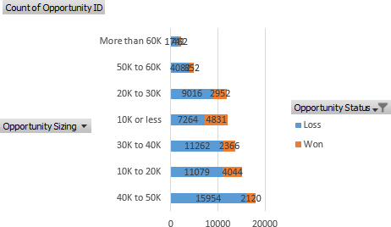
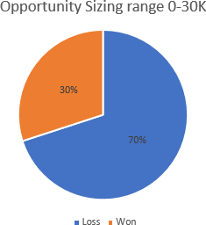
PART III A : Generating Insights
Sales Pipeline Conversion at a SaaS Startup
Variable under consideration: Opportunity Sizing
The opportunity conversion rate is significantly higher for clients with potential revenue in 0-30K range

Slide 24
PART III A : Generating Insights
Sales Pipeline Conversion at a SaaS Startup
Recommendations
Focus on the following Categories for newer leads for ensuring high Conversion rate
ERP implementation as the type of solution offered to the customers
Enterprise Sellers as the B2B Sales Medium
Client Revenue Sizing in Range (100 K or less)
Existing customers
Opportunity Sizing in range (0-30 K)
Corresponding Insights
1. Unusually large number of Opportunities come from ERP Implementation Category and they have better opportunity Conversion rate than Average Opportunity Conversion Rate
2. Most opportunities are from Marketing and Enterprise Sellers with the Enterprise Sellers having a better opportunity conversion rate than average opportunity conversion rate
3. Unusually large number of opportunities come from clients in revenue size 100K or less
4. The conversion rate is higher for existing customers despite the number of opportunities unusually large from newer customers
5. The opportunity conversion rate is significantly higher for clients with potential revenue in 0-30K range

Slide 25
PART III B : Presenting Findings
Sales Pipeline Conversion at a SaaS Startup
Final Recommendations
Focus on the following Categories for newer leads for ensuring high Conversion rate
ERP implementation as the type of solution offered to the customers
Enterprise Sellers as the B2B Sales Medium
Client Revenue Sizing in Range (100 K or less)
Existing customers
Opportunity Sizing in range (0-30 K)

